Slide 1



Ionic sepintas lalu
khirulnizam.com

Slide 2
OVERVIEW
TO IONIC FRAMEWORK

Slide 3

What is Ionic?
Ionic Framework is an open source UI toolkit for building performant, high-quality mobile and desktop apps using web technologies (HTML, CSS, and JavaScript).

Slide 4
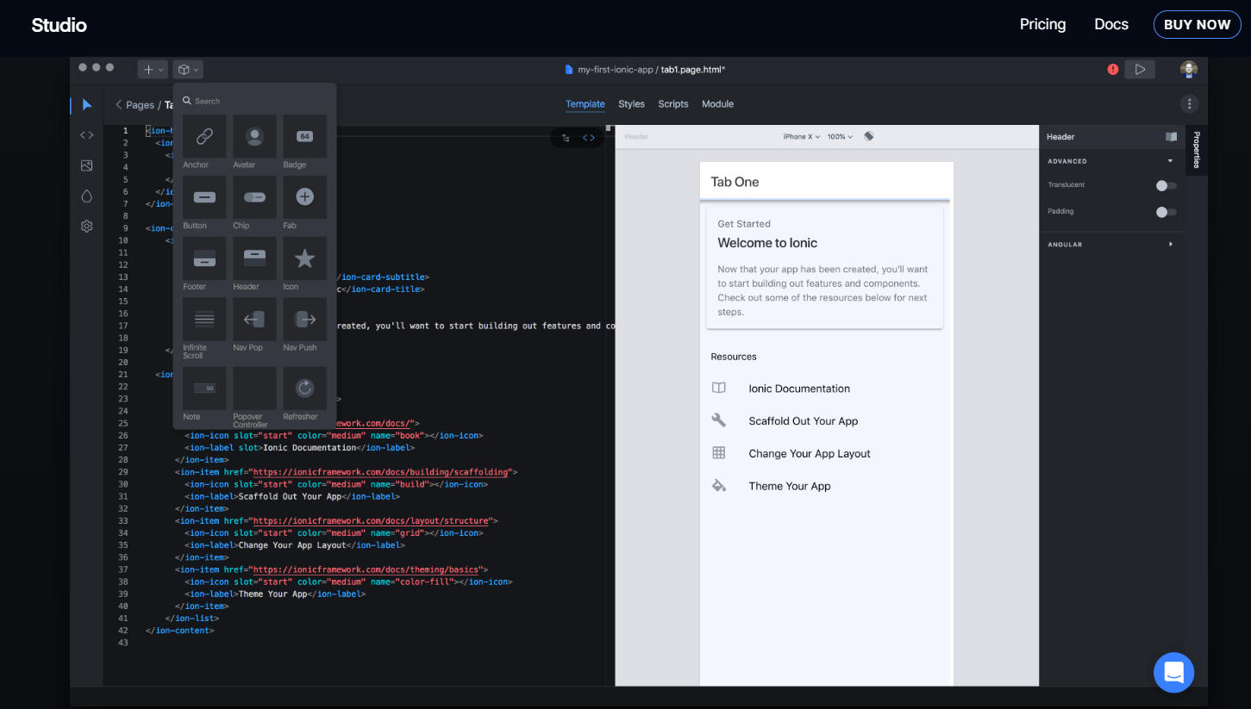
Ionic Studio

Slide 5
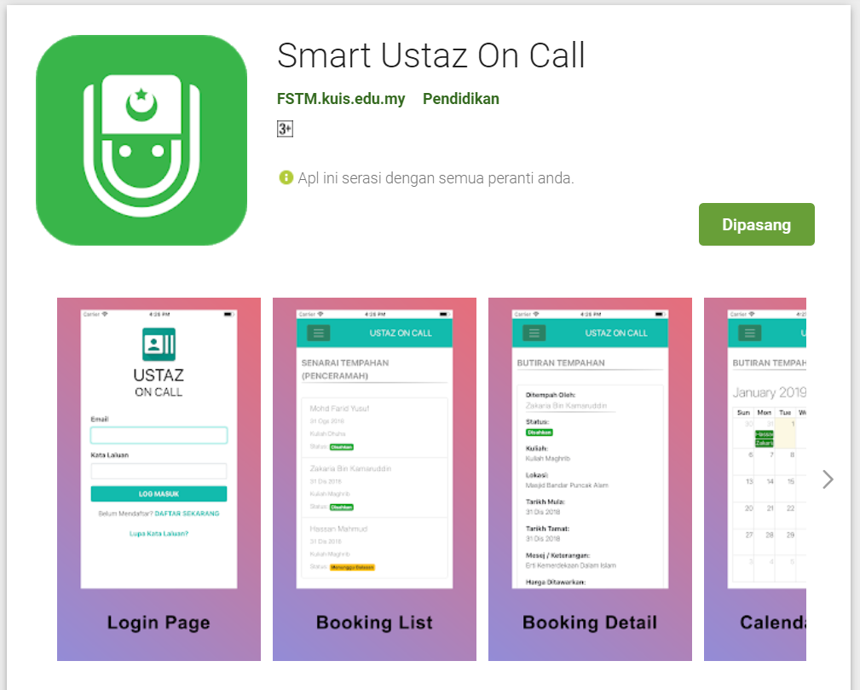
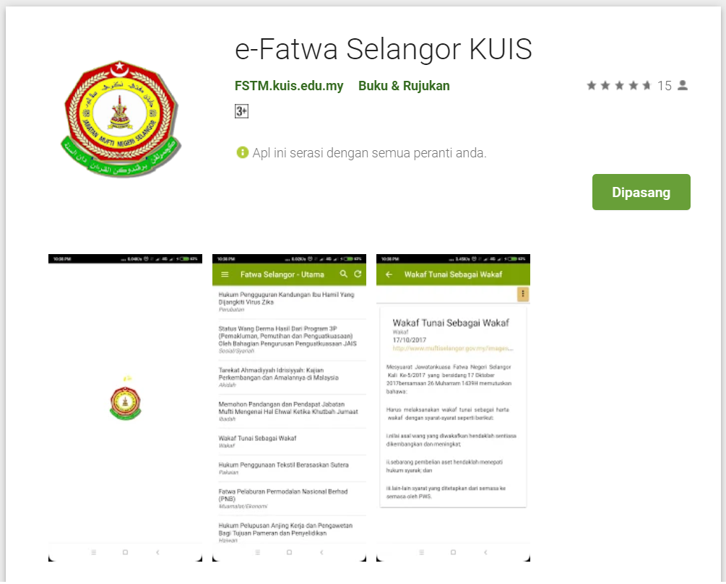
Available apps

Slide 6
IOS & Android Software Development
In a nutshell

Slide 7





Android Studio
(Java & Kotlin)
Android Device
NATIVE - 2 X WORK
XCode (Swift & Objective C)
iPhone/iPad

Slide 8

1 x WORK
Compile with Android SDK
Android Device
Cordova
Framework
Hybrid
XCode Project
iPhone/iPad

Slide 9
Cordova
Framework
Hybrid
WEB LAYER
NATIVE APP

Slide 10
1 x WORK
Build Progressive Web Apps
Android Device
Build Progressive Web Apps
Cordova
Framework
Hybrid
iPhone/iPad

Slide 11


1 x WORK
Android Studio
Android Device
+
XCode
iPhone/iPad

Slide 12
https://capacitor.ionicframework.com/

Slide 13



WHY IONIC?
Framework specifically to develop apps
Multiple platforms-Android, IOS, Windows, Amazon etc
Apps development using HTML & Typescript (subset of Javascript)
Plugins (camera, thumbprint, bluetooth, printer etc etc etc)

Slide 14
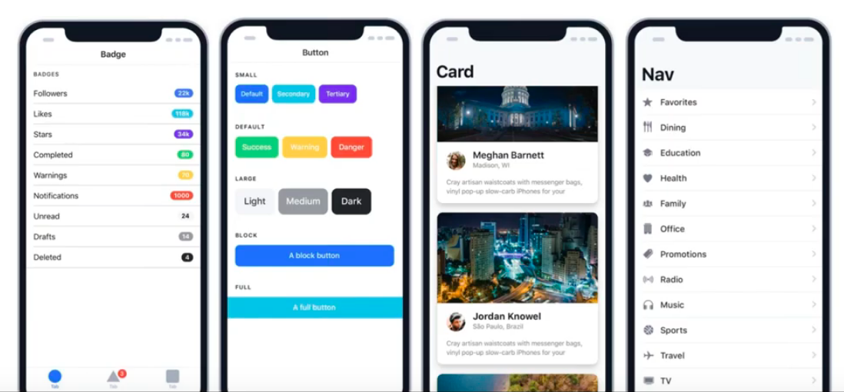
WHY IONIC?
Large COMMUNITY for support
Pre built gestures & animation
100+ UI Components
Everything is OPEN SOURCE
Built with Ionic

Slide 15
Software to start Ionic?

Slide 16
What do you need?
To run IONIC:
Node Package Manager (NPM)
Ionic Cordova Framework
Google Chrome Web Browser
To develop/publish app
VSCode OR any other IDE (with Typescript Plugin)
Ionic Capacitor
Android SDK or Xcode - can be done later

Slide 17
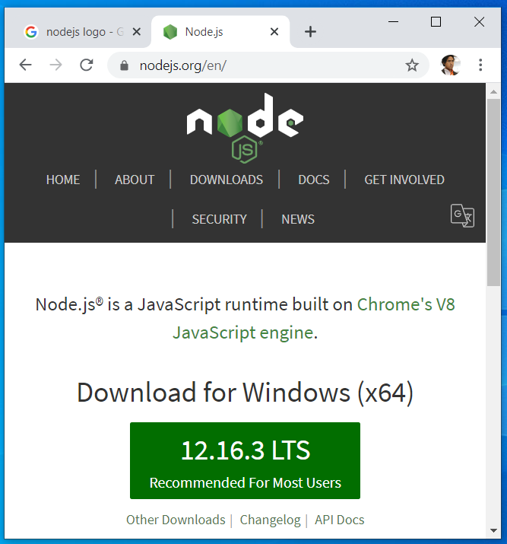

Download from nodejs.org
Download and install the LTS version
http://nodejs.org

Slide 18
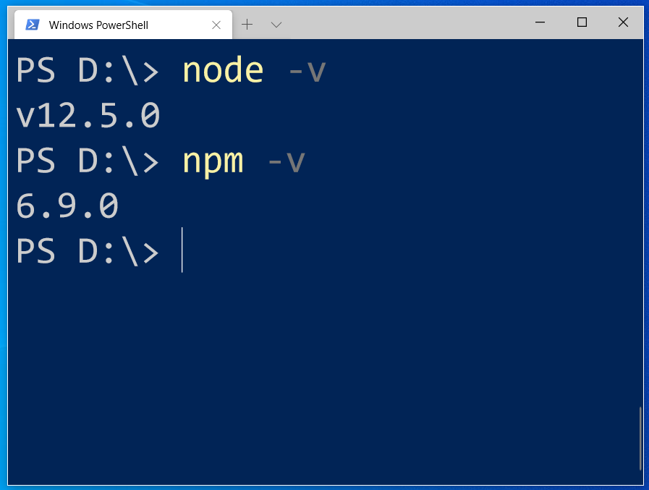
After install NodeJS from nodejs.org
node -v
npm -v

Slide 19
2. From command terminal run:
npm install -g ionic cordova

Slide 20
Now, let’s install the tools

Slide 21
Install VSCode/sublime
NodeJS
Tutorial is here bit.ly/ionickerul
Install Google Chrome Browser
(If you don’t have, you should)

Slide 22
Before we start coding, some basic stuff...

Slide 23
-HTML?
-CSS ?
-TypeScript ?

Slide 24
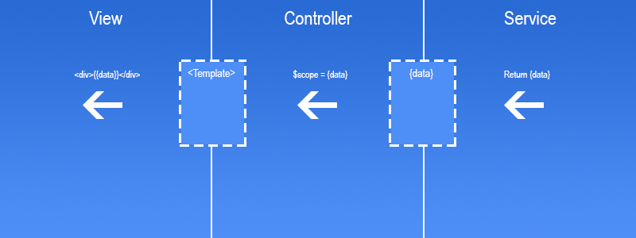
Simple MVC in Ionic
.HTML | .TS | services .TS /Model

Slide 25
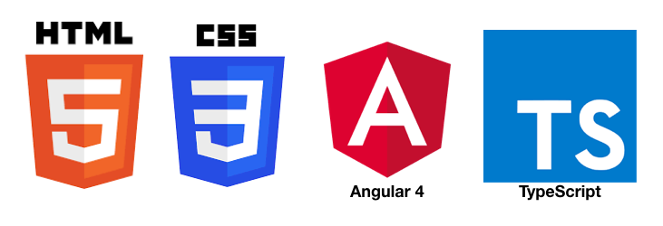
HTML
-Hyper Text Mark Up Language (HTML)
-Used to display the interface
-Write in tags,
-Example- <strong>Hello</strong> → Hello
-Ionic has its own built in tags
<ion-list></ion-list>
<ion-item></ion-item>
<ion-grid></ion-grid>
-HTML in Ionic is “AngularJS Flavoured”
-Have to use Angular Syntax for data and clicks
-Example- (click), *ngFor etc

Slide 26
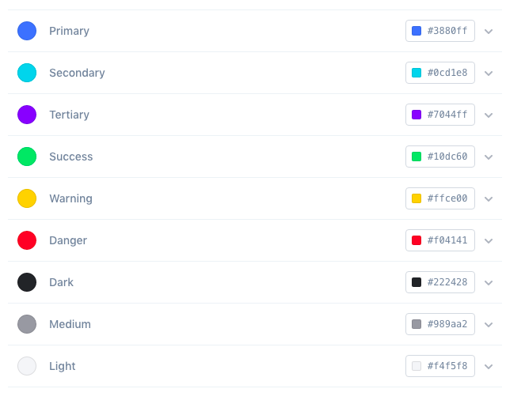
CSS or SCSS
-Cascading Style Sheets (CSS)
-Used for styling, very straightforward
-Each generated Ionic page comes with built in own CSS
-Can assist in ‘theming’ the app
-Ionic has standard built in colours
-Primary, Secondary, Danger, Light & Dark
Built in colours that can be added/edited

Slide 27
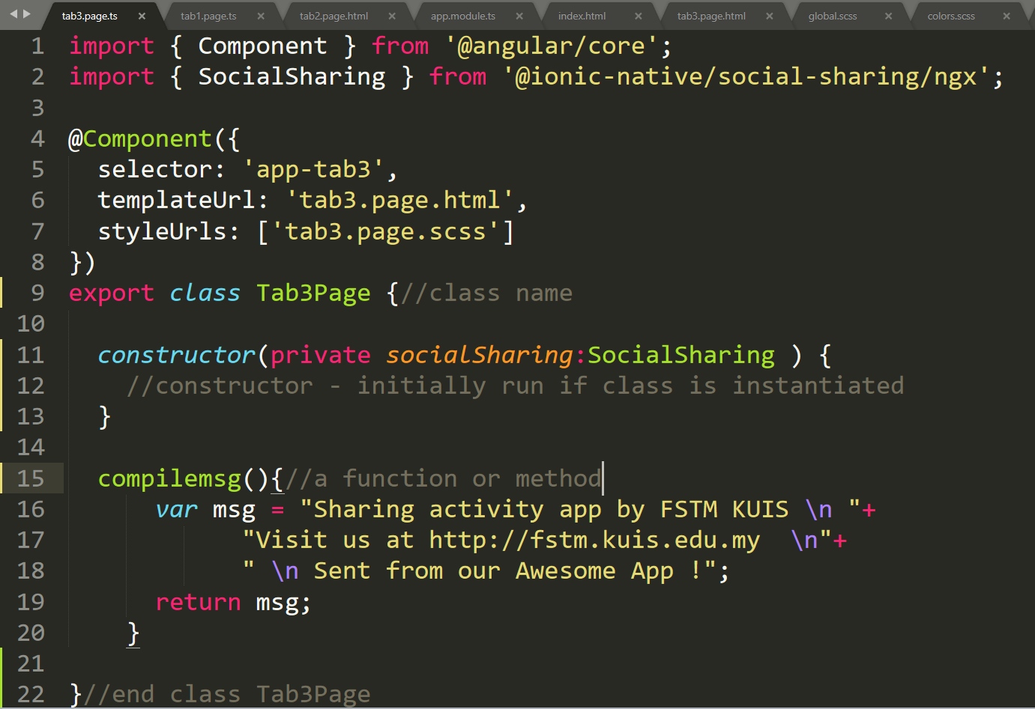
Class Function

Slide 28
Hello World ionic

Slide 29
1. Start a project
ionic start appfstm tabs

Slide 30
2. CD into Directory & Run the project
ionic serve

Slide 31
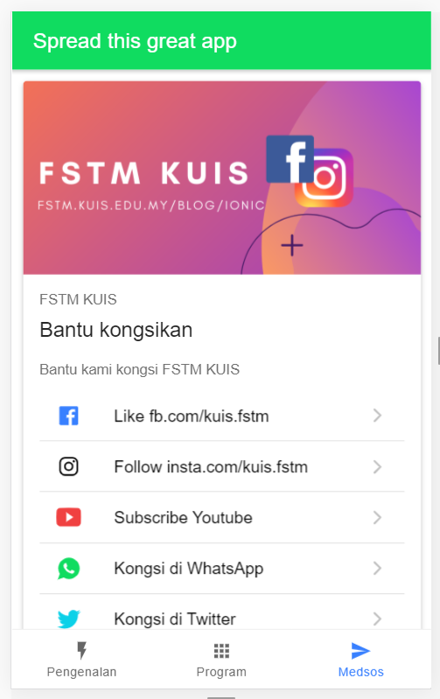

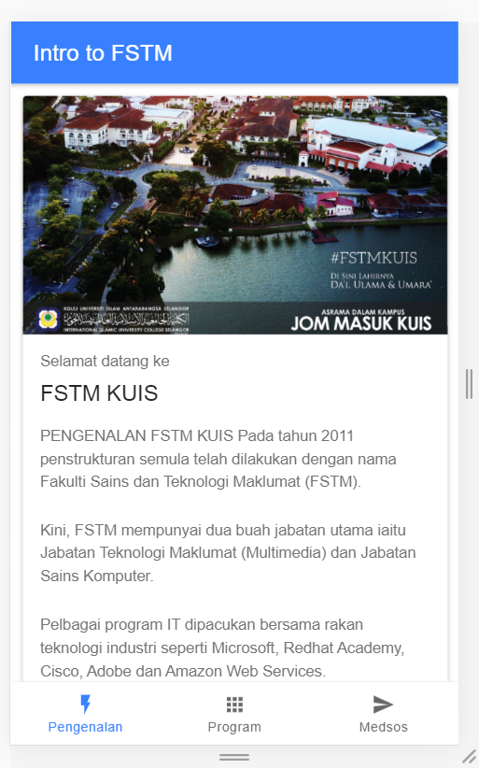
Next tab2 and tab3

Slide 32


T02 HTML interface
(antaramuka)

Slide 33
T02 Antaramuka
HTML
(sambungan bahagian2)

Slide 34
1. Start a project
ionic start appfstm tabs

Slide 35
2. CD into Directory & Run the project
ionic serve

Slide 36
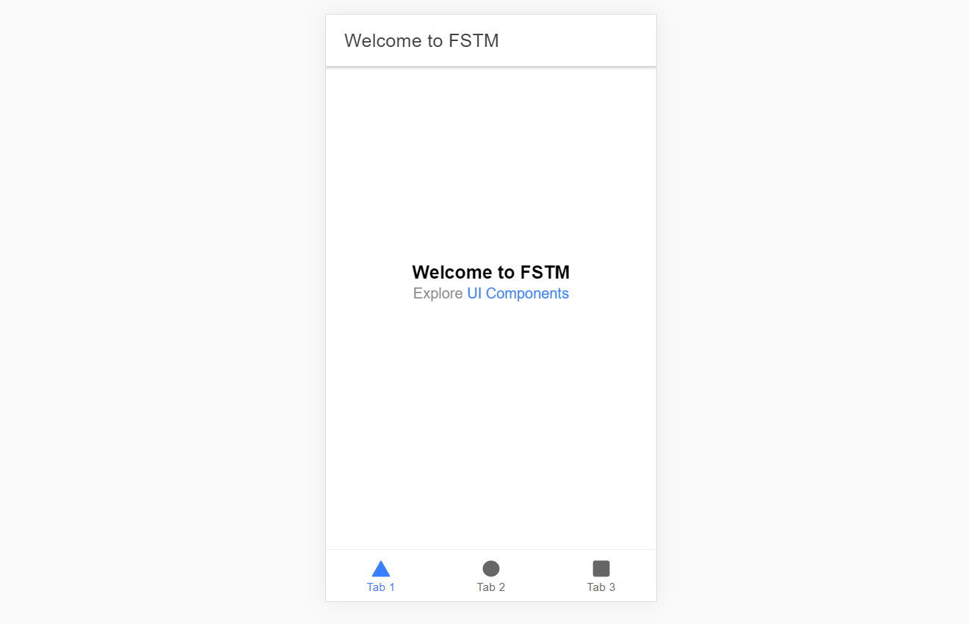
Output : ionic serve

Slide 37
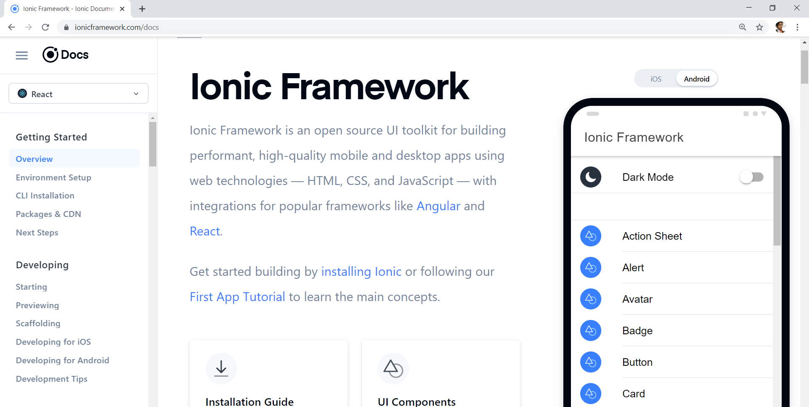
Always refer to documentations: https://ionicframework.com/docs

Slide 38
HTML
-Hyper Text Mark Up Language (HTML)
-Used to display the interface
-Write in tags,
-Example- <strong>Hello</strong> → Hello
-Ionic has its own built in tags
<ion-list></ion-list>
<ion-item></ion-item>
<ion-grid></ion-grid>
-HTML in Ionic is “AngularJS Flavoured”
-Have to use Angular Syntax for data and clicks
-Example- (click), *ngFor etc

Slide 39
CSS or SCSS
-Cascading Style Sheets (CSS)
-Used for styling, very straightforward
-Each generated Ionic page comes with built in own CSS
-Can assist in ‘theming’ the app
-Ionic has standard built in colours
-Primary, Secondary, Danger, Light & Dark
Built in colours that can be added/edited

Slide 40
Next tab2 and tab3

Slide 41
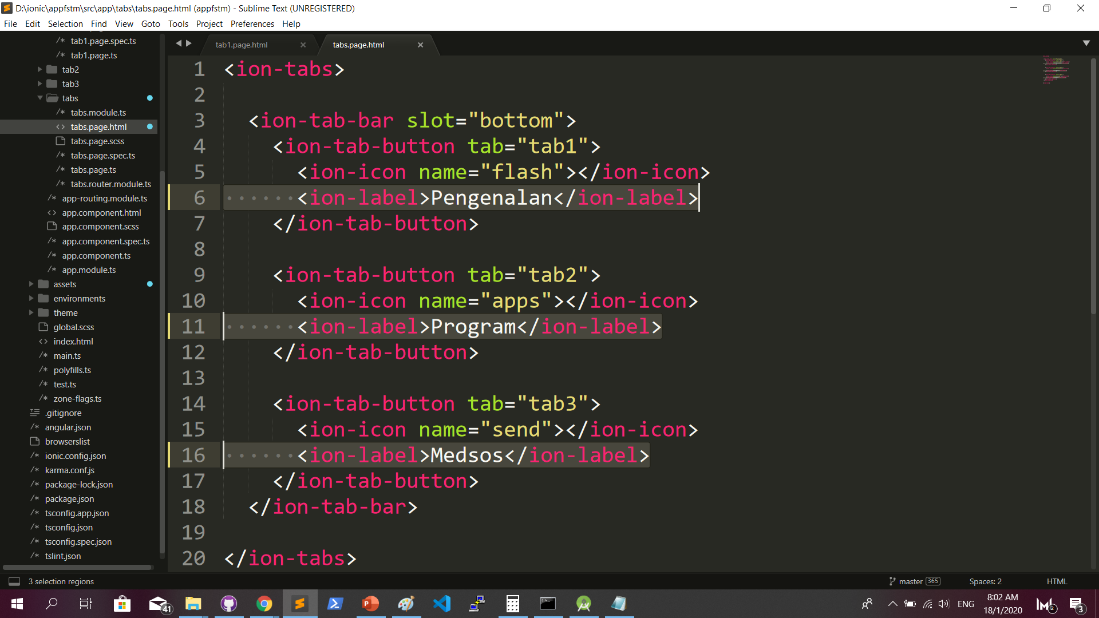
Some interface cosmetics: src/app/tabs/tabs.page.html

Slide 42
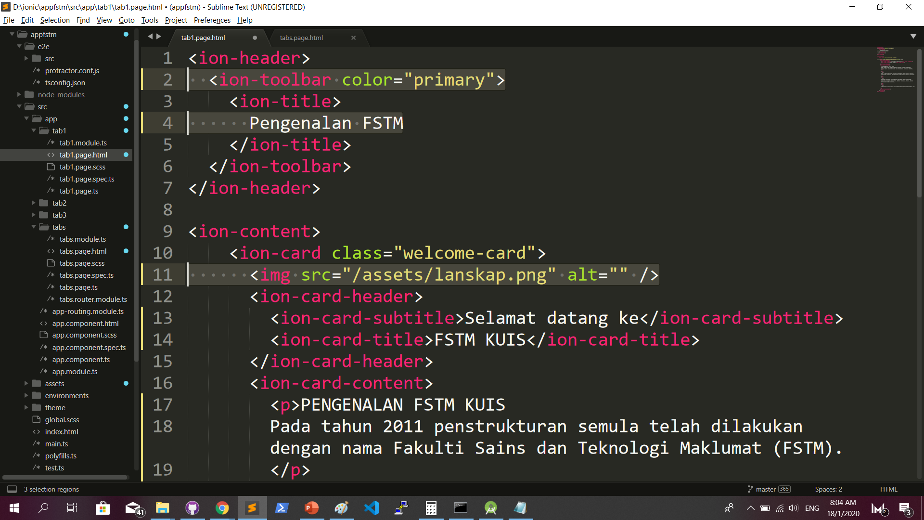
More interface cosmetics: src/app/tab1/tab1.page.html

Slide 43
Run ionic serve

Slide 44
Next tab2 and tab3

Slide 45
Codes & slides github.com/khirulnizam/ionic5

Slide 46
T03 Navigasi
(page navigation)

Slide 47
Page Navigation
+ routerLink (in .html) + NavController (in .ts)

Slide 48
routerLink in HTML
PAGE 1
PAGE 2
See app-routing.module.ts for page name

Slide 49
Exercise : Link to new page
Generate new pages
ionic g page info
ionic g page form

Slide 50
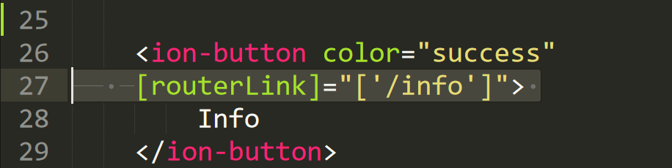
Exercise : Link to new page

Slide 51
NavController in TS
PAGE 1
PAGE 2
See app-routing.module.ts for page name

Slide 52
Add simple form interaction
+ Form Button + Alert function

Slide 53
Try building a button and make an alert
helloWorld(){
alert(“Hello Ionic!”)
}
<ion-button (click)=”helloWorld()”> ALERT </ion-button>
info.page.ts
info.page.html

Slide 54

Codes & slides github.com/khirulnizam/ionic5

Slide 55

T04 TypeScript

Slide 56
TypeScript
-A subset of Javascript
-Part of ECMA6 standard
-The ‘brains’ behind your app
-Used for processing & handling data
Example- calculation, accessing DB etc
-Ionic has standard built in to its TS:
NavController, ModalController etc

Slide 57
Typescript Syntax : Function
n1:number;
n2:number;
output:any;
addnumbers(){
output=n1+n2;
displayresult( );
}
displayresult( ){
alert(“Output: ”+output);
}

Slide 58
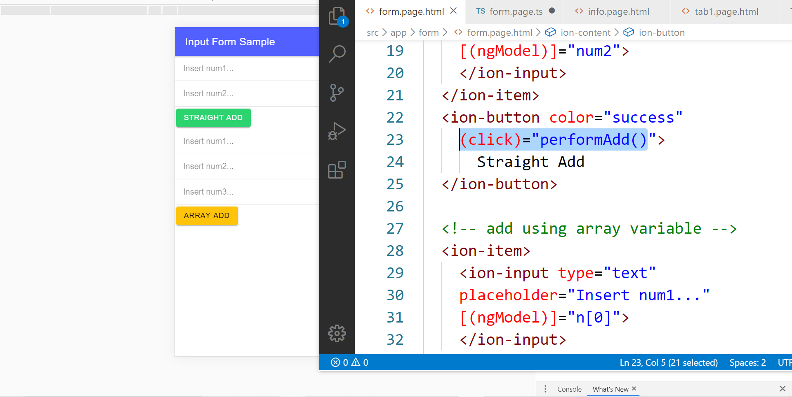
In file .HTML

Slide 59
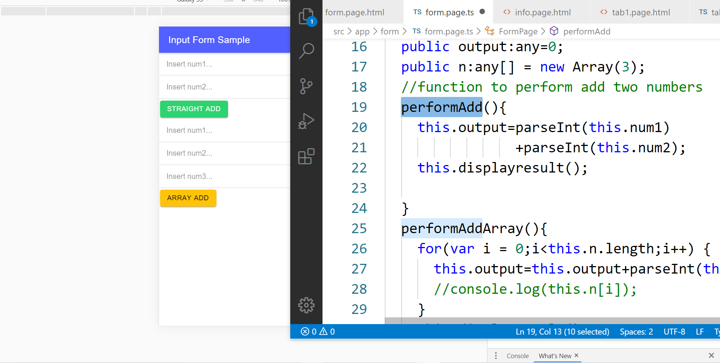
In file .TS

Slide 60
TypeScript Syntax : EX1 variable
What is a variable?
A variable acts as a container for values in a programming code.
var pi:number = 3.14;
Var num1:number=5;
var name:string =“enKerul”;
Use any to loosely-type the variable data type.
Data types:
any
can be numbers or strings
string
“this is string ” + “ concat ”
number
Double 3.14, or integer 5
array
can be a collection of Var, Strings or Objects

Slide 61
Typescript Syntax : EX2 String manipulation & Casting
//to convert String to number
var str = "54";
//easy way by using + operator
var num = +str; var num = parseInt(str);
String manipulation?
var str:string = "3.14";
var pi:number = 3.14;
console.log("pi is "+pi);
console.log("tau is "+(2 * pi));

Slide 62
Typescript Syntax : EX3 Array
Array? Array
can be a collection of Var, Strings or Objects
// A list literal.
var numbers = [4, 1, 5, 6, 3, 2];
for(var i=0;i<numbers.length; i++)
{
sum=sum+numbers[i]);
console.log(“Sum: ”+sum);
}
-----
Output
Sum: 21

Slide 63
Typescript Syntax : EX4 Associative array
Associative Array?
Array with key and value pairs (not index number).
// A map literal.
// Asociative array
var gases = [
'He': 'Helium',
'Ne': 'Neon',
'Ar': 'Argon’,
];
console.log(gases['Ne’]);
-------------------------
Output: Neon

Slide 64



T05 Kamera (installing camera plug-ins)

Slide 65
Codes & slides github.com/khirulnizam/ionic5

Slide 66
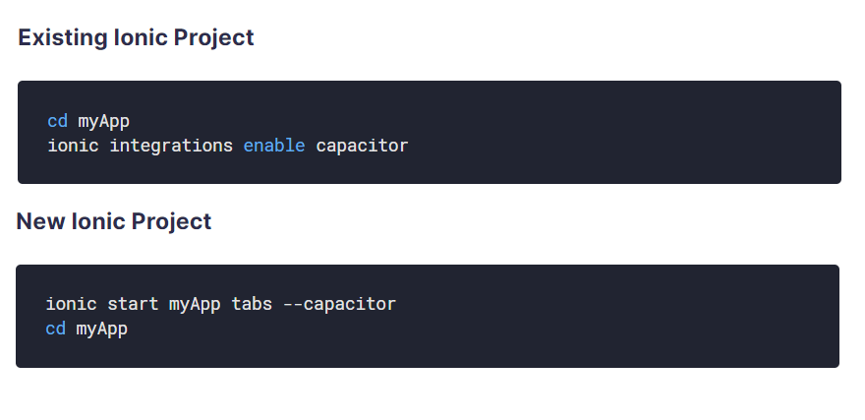
Using Capacitor with Ionic

Slide 67
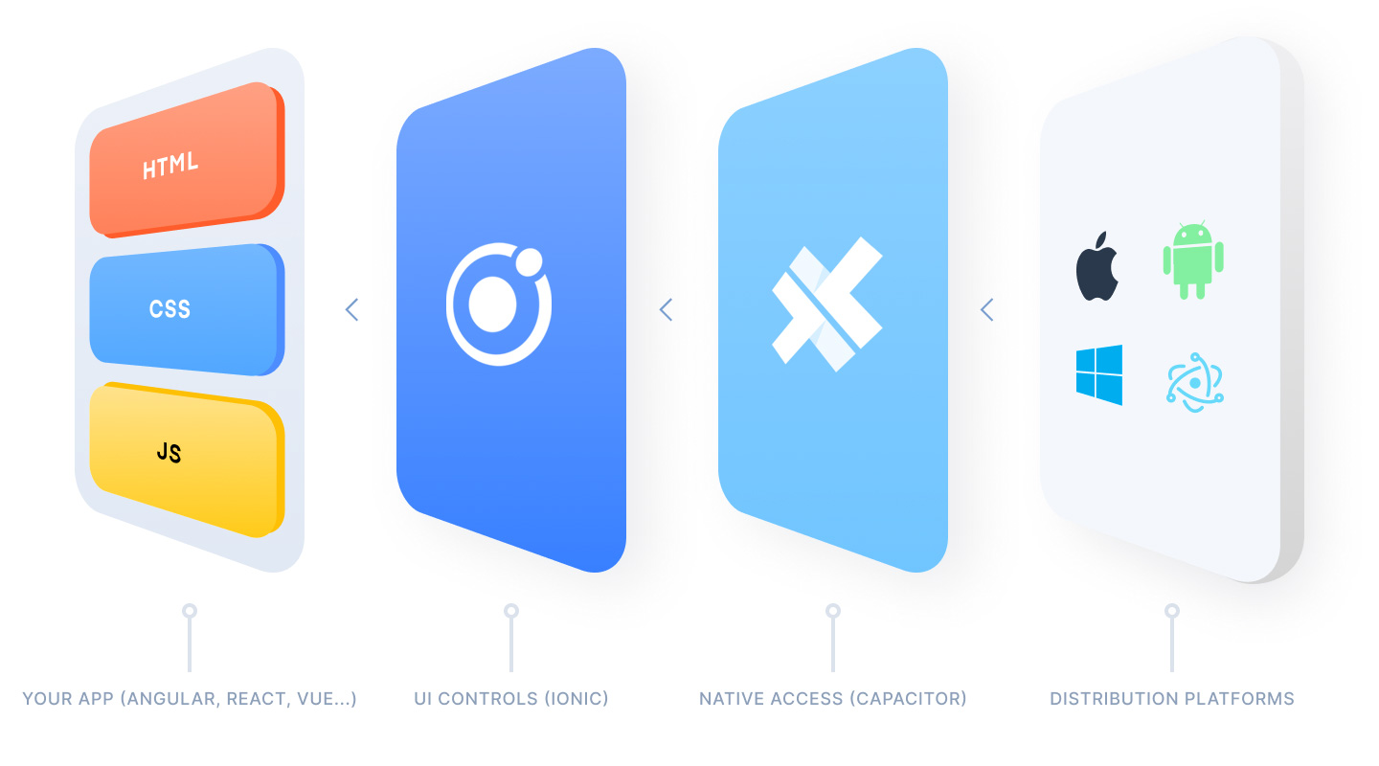
Ionic Capacitor
https://ionicframework.com/resources/articles/capacitor-vs-cordova-modern-hybrid-app-development
runs modern Web Apps natively on iOS, Android, Electron, and Web

Slide 68
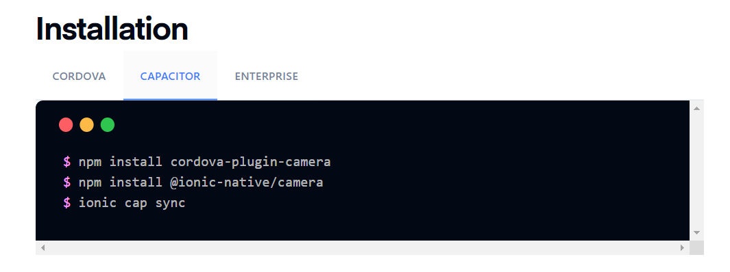
Install camera support : ionicframework.com/docs/native/camera

Slide 69
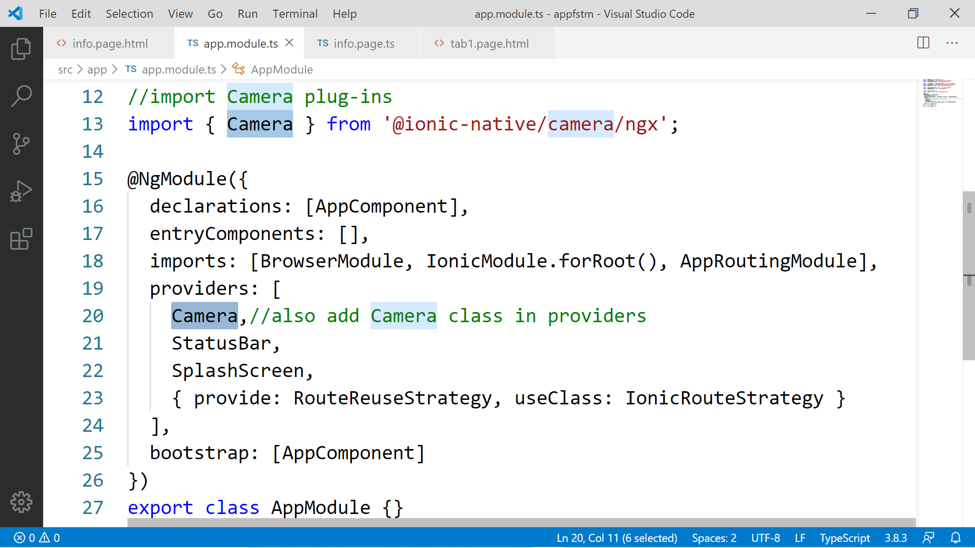

Slide 70
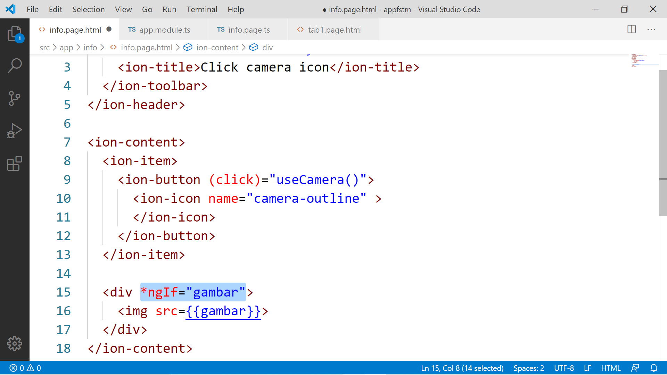

Slide 71
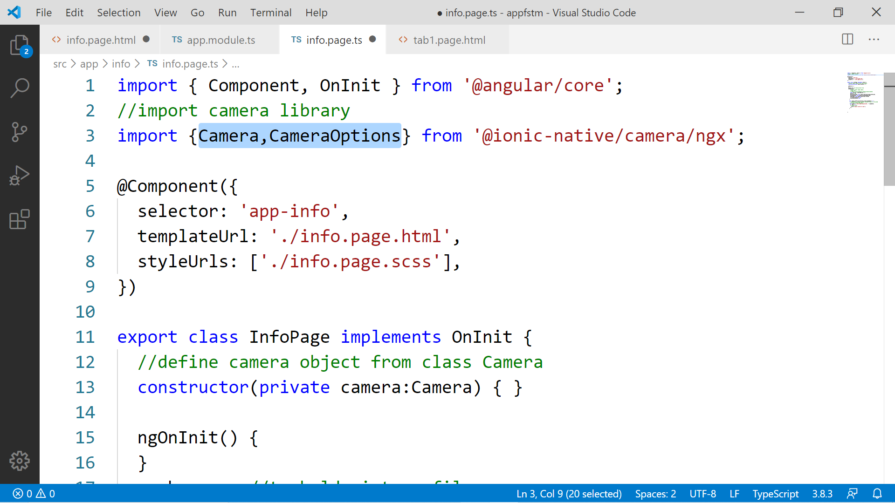

Slide 72
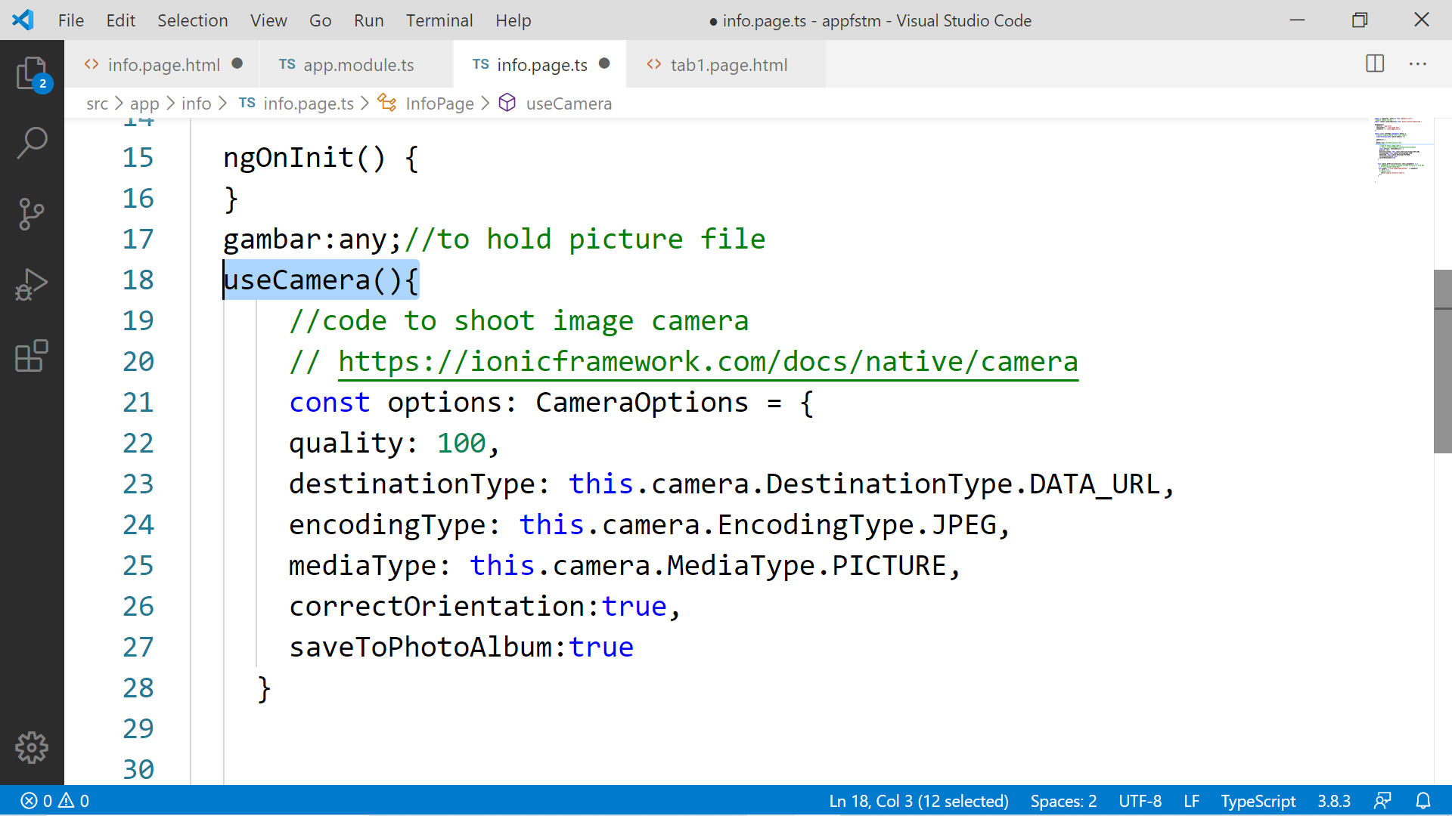

Slide 73
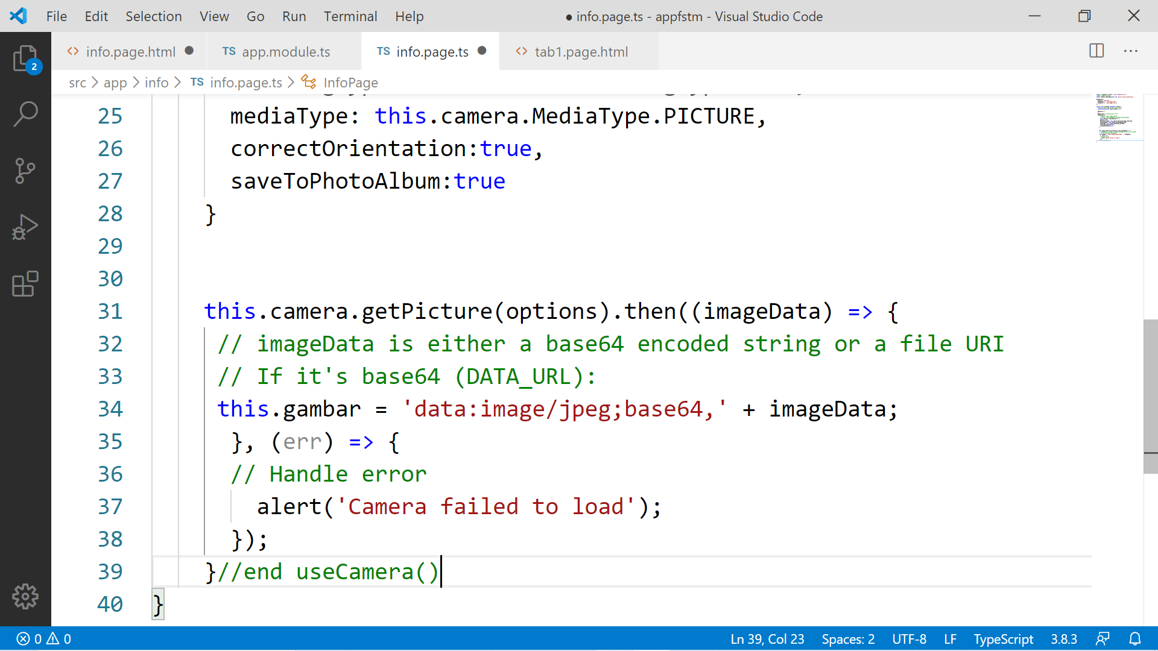

Slide 74
Migration Cordova to Capacitor - error: package android.support.v4.content does not exist
npm install jetifier
npx jetifier
npx cap sync android

Slide 75
Ionic Capacitor
https://ionicframework.com/resources/articles/capacitor-vs-cordova-modern-hybrid-app-development
runs modern Web Apps natively on iOS, Android, Electron, and Web

Slide 76

Previously we have CORDOVA

Slide 77
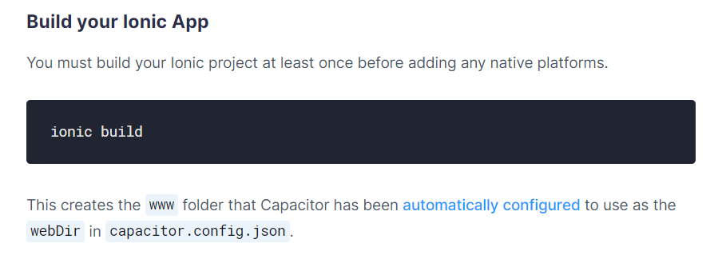
Ionic build

Slide 78
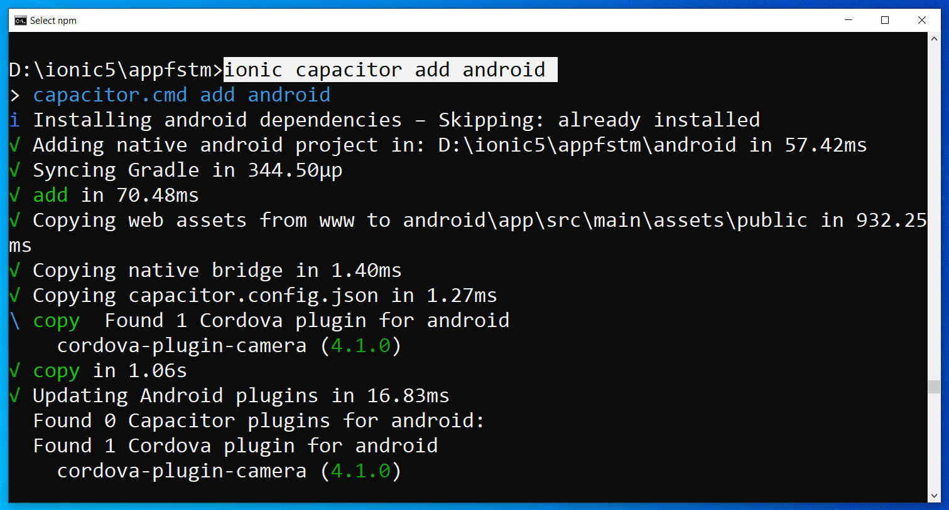
Run only once for each ionic project
To update Android project, execute
ionic build
npx cap copy

Slide 79
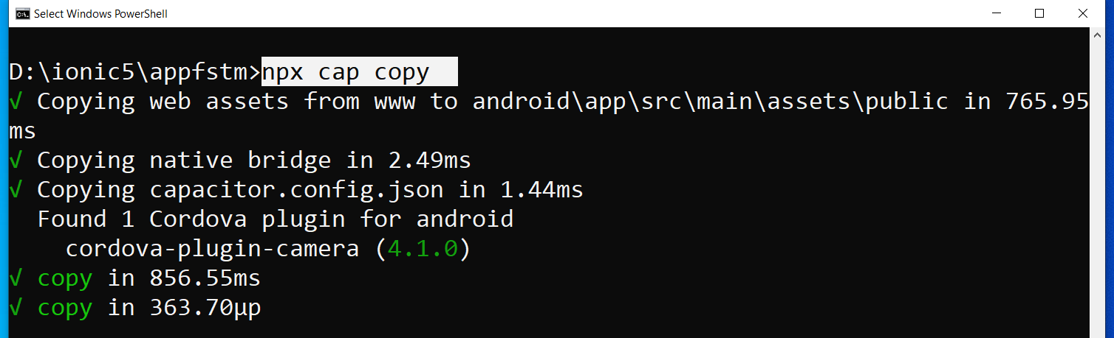
After finish installing the camera plug-ins

Slide 80
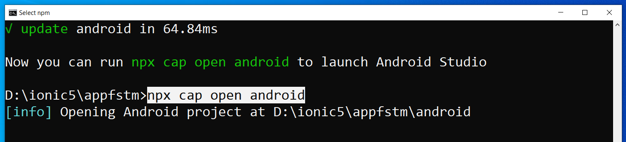
To open project on Android Studio

Slide 81
Codes & slides github.com/khirulnizam/ionic5

Slide 82
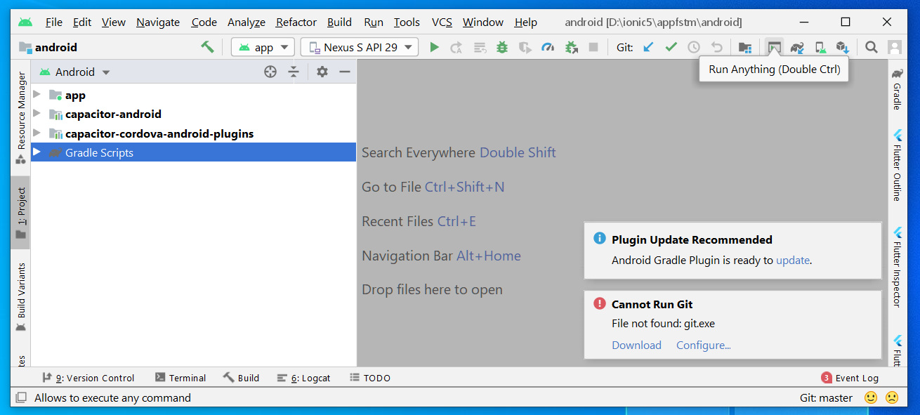
Open in Android Studio

Slide 83
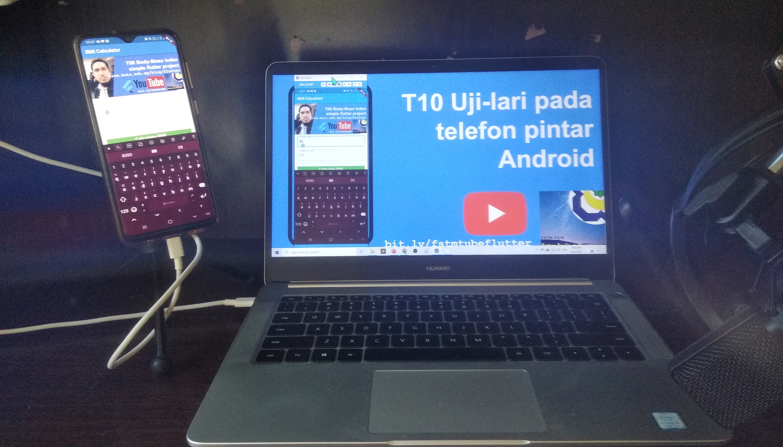


Uji-lari
apps pada
telefon
Android

Slide 84

Android Studio 3.6 & SDK developer.android.com/studio

Slide 85
Path settings (environment variables)
ANDROID_SDK_ROOT
JAVA_HOME

Slide 86
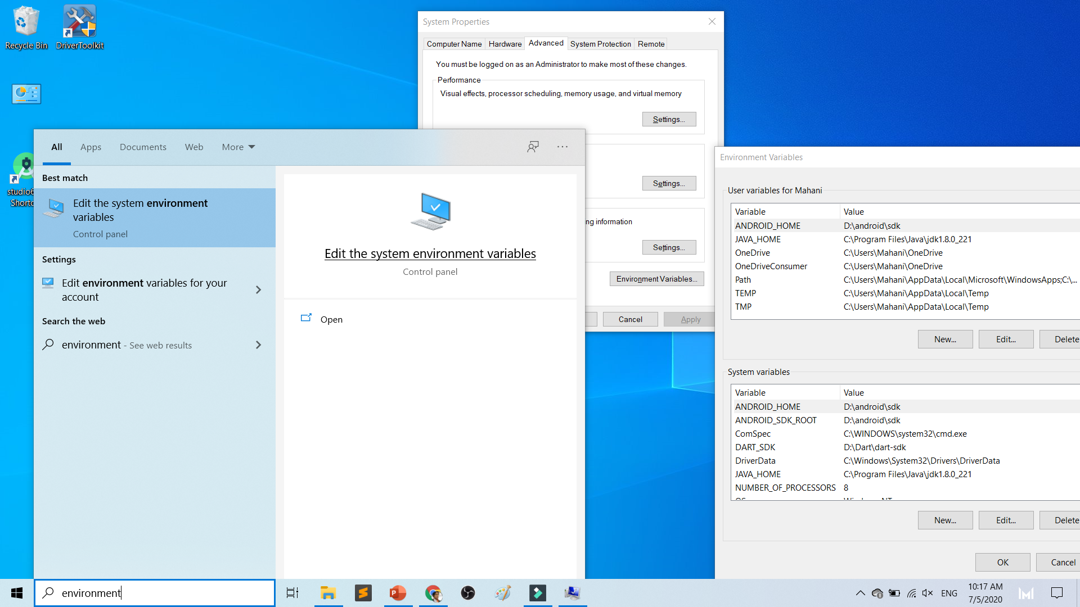

Slide 87
To deploy
Android Studio
Android SDK
Android Phone with USB Debugging enabled
ADB Bridge
USB Data-cable for Actual Device

Slide 88
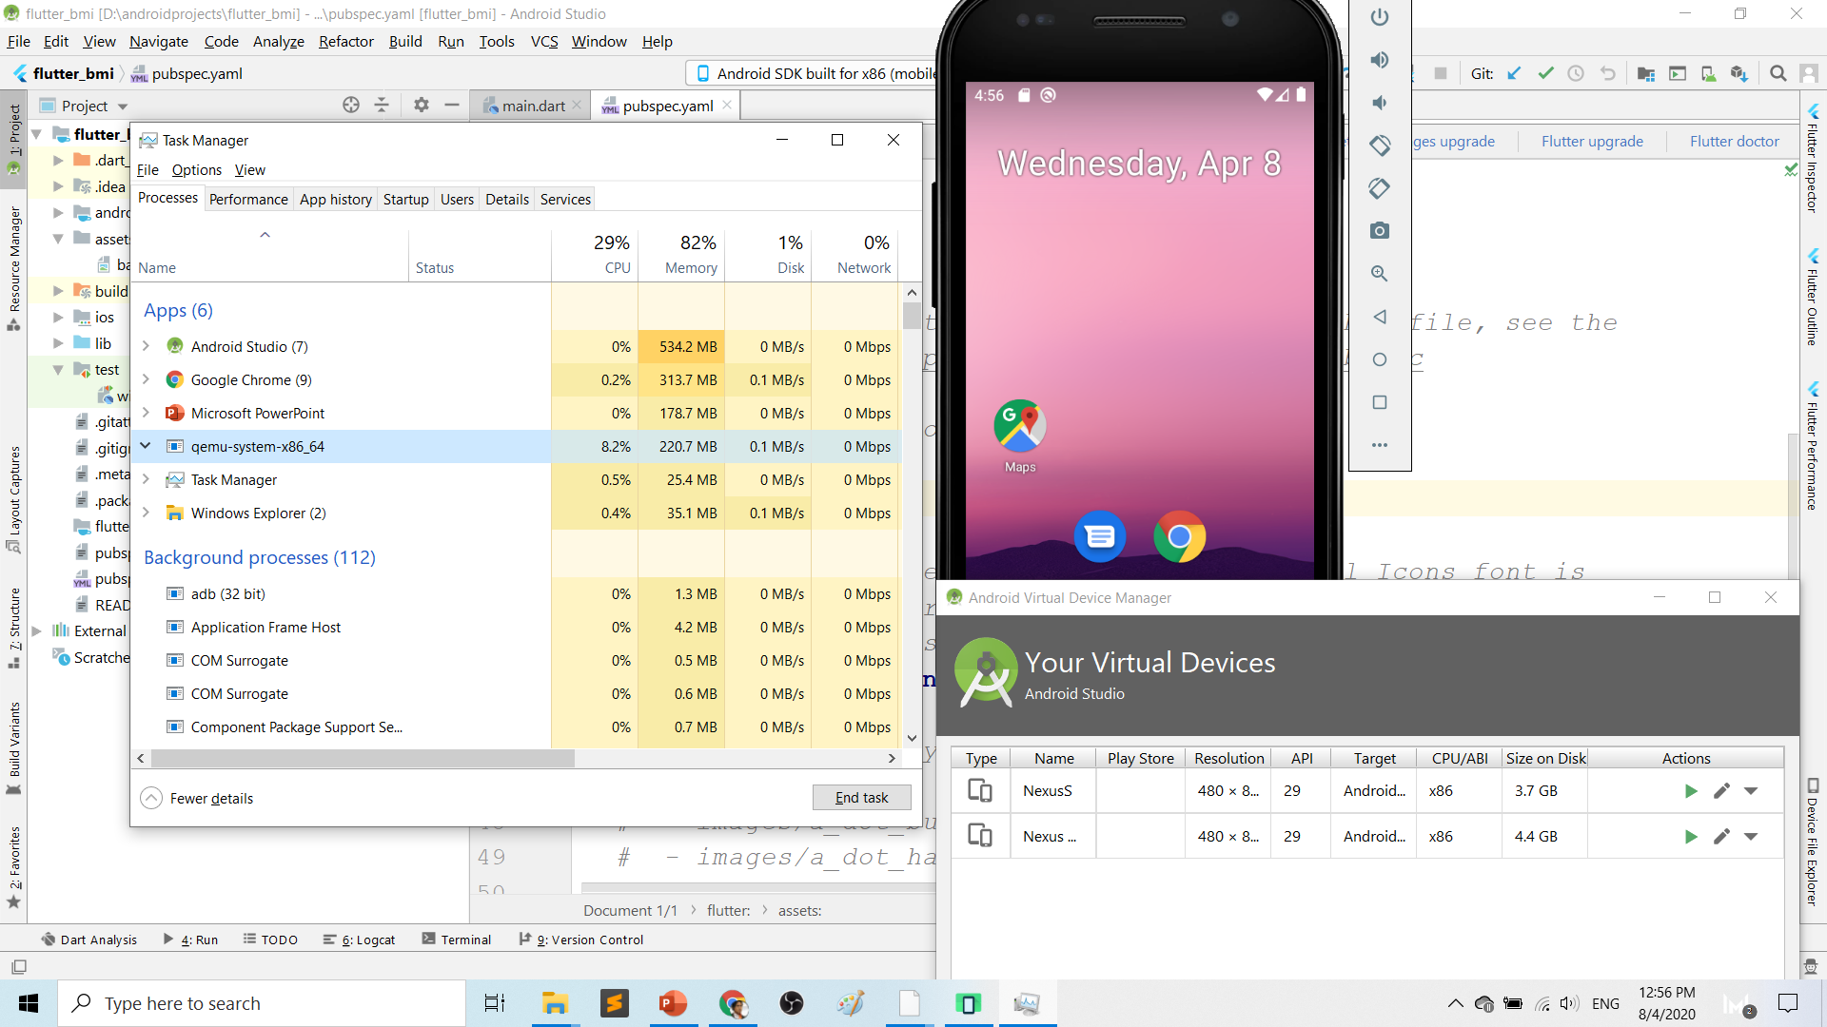
Play.google.com
What’s wrong with Android Studio & Emulator? RESOURCE-HUNGER

Slide 89
Requirements 1. USB debugging ON- phone 2. Connect USB Cable 3. Install ADB driver in PC

Slide 90
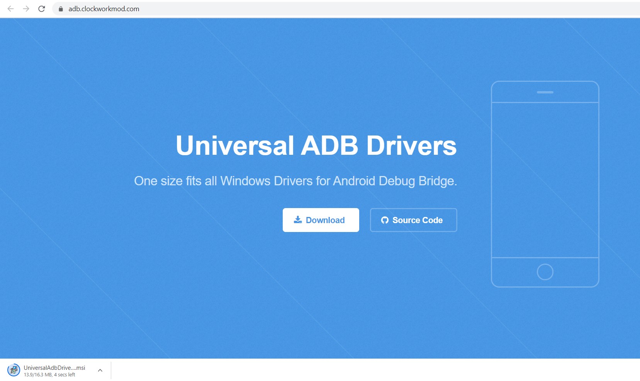
Play.google.com
Install universal debug driver
https://adb.clockworkmod.com/
Download & install universal debug

Slide 91
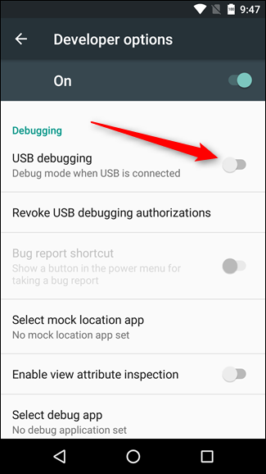
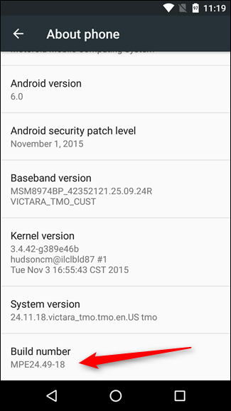
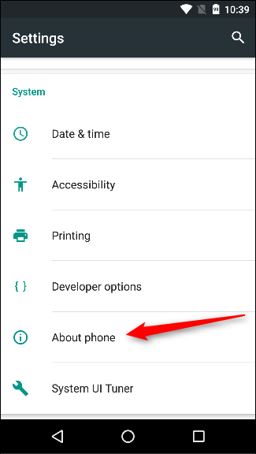
First time to on USB Debugging?
Developer options enable
Press 7X on build number
press 7x

Slide 92
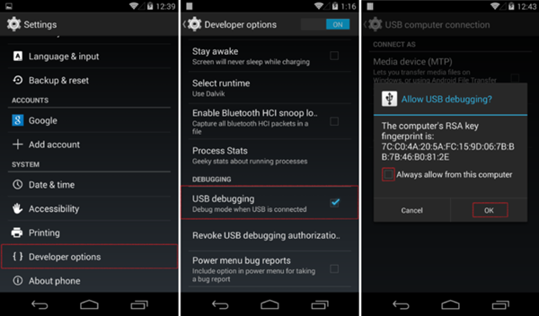
First time Allow USB debugging?

Slide 93
Ionic build

Slide 94
Create Android project/platform ionic capacitor add android
Run only once for each ionic project
To update Android project, execute
ionic build
npx cap copy

Slide 95
Copy to www to android project npx cap copy

Slide 96
To open project on Android Studio npx cap open android

Slide 97
Open in Android Studio

Slide 98
Codes & slides github.com/khirulnizam/ionic5

Slide 99


T07 Pilihan Selection : if…else, ngIf
Codes & slides
github.com/khirulnizam/ionic5

Slide 100
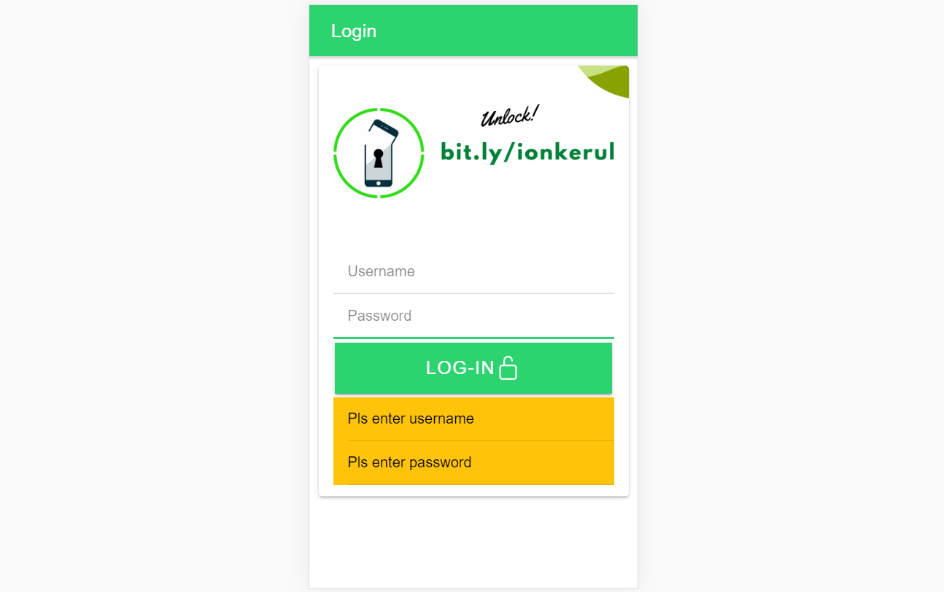
Output overview

Slide 101
Create a new page
ionic g page login
(selection exercise)

Slide 102
[(ngModel)]
Example:
IN TYPESCRIPT:
username:any;
password:any;
IN HTML:
<ion-input [(ngModel)]= “username”>
</ion-input>
<ion-input [(ngModel)]= “password”>
</ion-input>
[(ngModel)] USED IN HTML to capture what is typed into input to TypeScript

Slide 103
*ngIf used in HTML
Usually used for array iterations
Example:
IN HTML
<div *ngIf= “ username==null ”>
Pls enter username
</div>
<div *ngIf= “ password==null ”>
Pls enter password
</div>
*ngIf USED IN HTML

Slide 104
*ngIf … else used in HTML
<div *ngIf="gambar; else noImageYet">
<img src="{{gambar}}">
</div>
<ng-template #noImageYet>
<img src="./assets/noimagep.png">
</ng-template>
*ngIf … else USED IN HTML

Slide 105
IF...ELSE IF...ELSE AND *ngIFStatements
Usually used for selection and/or filtering
Example:
if(username== null){
alert(“Pls insert username”);
}
else if(password==null){
alert(“Pls insert password”);
}
else {
alert(“Welcome user”);
}
IF...ELSE IF..ELSE USED IN TYPESCRIPT IS EXACTLY THE SAME AS JAVASCRIPT

Slide 106
Output

Slide 107

T08 Ulangan Repetition : for, foreach, ngFor

Slide 108
Codes & slides github.com/khirulnizam/ionic5

Slide 109
Create a new page
ionic g page irepeat
(repetition exercise)

Slide 110
For Loop and *ngFor
Usually used for array iterations. Example:
negeri[0]= “Johor”;
negeri[1]= “Melaka”;
negeri[2]= “N. Sembilan”;
negeri[3]= “Selangor”;
for(var x=0;x<negeri.length;x++)
{
console.log(negeri[x]);
}
This will output in the console all the items in the array
FOR LOOP USED IN TYPESCRIPT

Slide 111
For Loop and *ngFor
Usually used for array iterations
Example:
IN TYPESCRIPT
negeri[0]= “Johor”;
negeri[1]= “Melaka”;
negeri[2]= “N. Sembilan”;
negeri[3]= “Selangor”;
IN HTML
<ion-item *ngFor= “let item of negeri”>
{{ item }}
</ion-item>
This will output all the negeris in HTML
*ngFor LOOP used in HTML

Slide 112

T09 Navigasi (navigation with parameters)

Slide 113
PARAMETERS
PAGE 1
(irepeat)
PAGE 2
(displayparams)
Nama: Kerul
Poskod: 43000
Negeri: Selangor
Nama: Kerul
Poskod: 43000
Negeri: Selangor
Nama: Kerul
Poskod: 43000
Negeri: Selangor

Slide 114
Navigation with Parameters
1. Using Router
TO SEND VALUES (CANNOT SEND OBJECTS)

Slide 115
2. Using Services
Navigation with Parameters
*TO SEND OBJECTS

Slide 116
Using ActivatedRoute
On app-routing.module.ts add param name, example /:id
Add /id when navigating
To get param
import {Router} from ‘@angular/router’
public route:Router
let the_id=this.route.snapshot.params.id

Slide 117
Using Services

Slide 118
USING SERVICES
HOME
SERVICES:
Functions
createUser(email, password)
{
…
}
loginUser(){
…
}
listUsers(){
…
}
DAFTAR
LOGIN
OTHER SERVICES

Slide 119
Using SERVICES
Services can be used globally
Can be used repeatedly
By different pages/other services

Slide 120
Generate a service
ionic g service service/data
Import Service and call from page ts

Slide 121


Slide 123


shareMasjid

Slide 124

& Firestore Auth

Slide 125


t10 Firebase (setup)

Slide 126

github.com/khirulnizam/ionic5 wasap.my/60129034614

Slide 127

Serverless option using Firebase
Serverless computing is a method of providing backend services on an as-used basis
A Serverless provider allows users to write and deploy code without the hassle of worrying about the underlying infrastructure
Scalable - the serverless vendor handles all of the scaling on demand
Simplified backend code
Quicker turnaround

Slide 128

JSON Concept
JSON: JavaScript Object Notation.
JSON is a lightweight data-interchange format
JSON format is text only, it can easily be sent to and from a server.

Slide 129
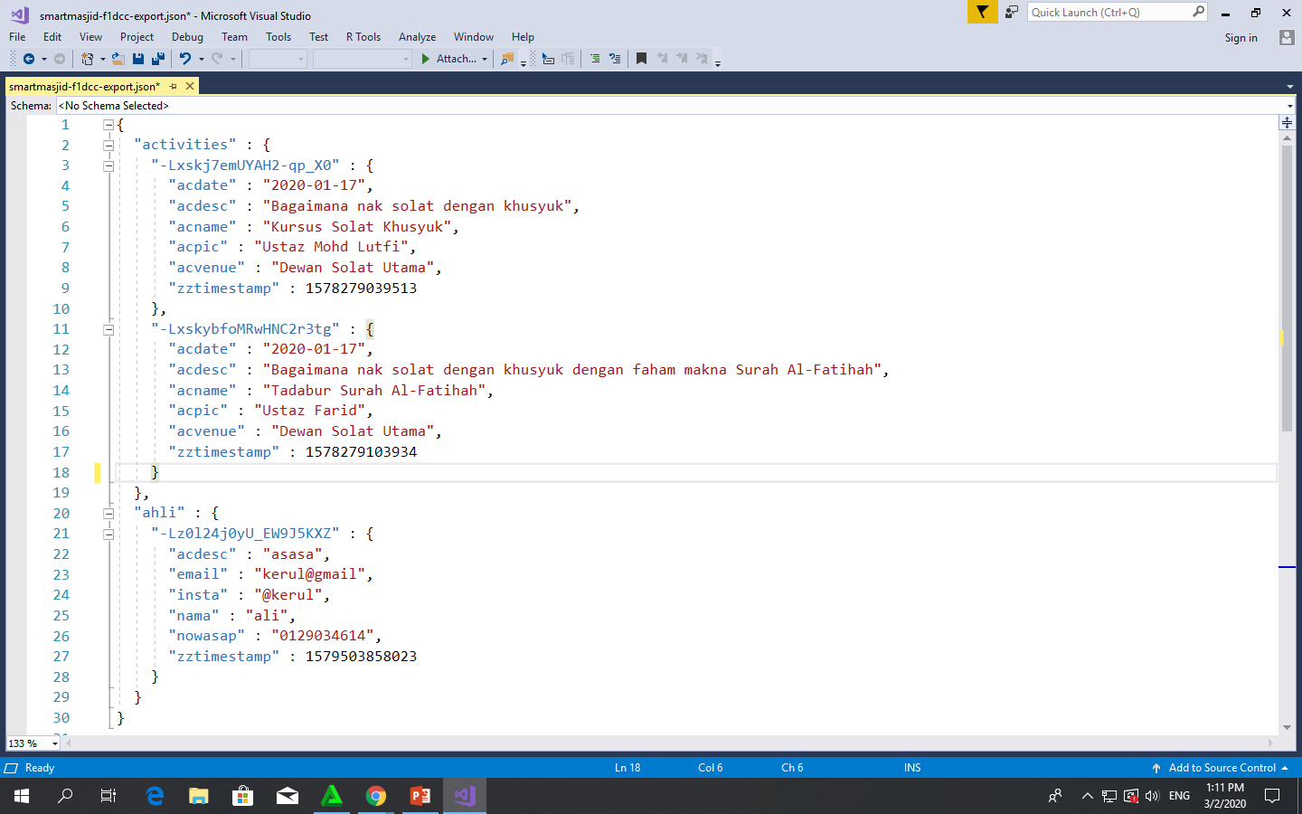
Play.google.com
JSON format example as applied in Firebase

Slide 130
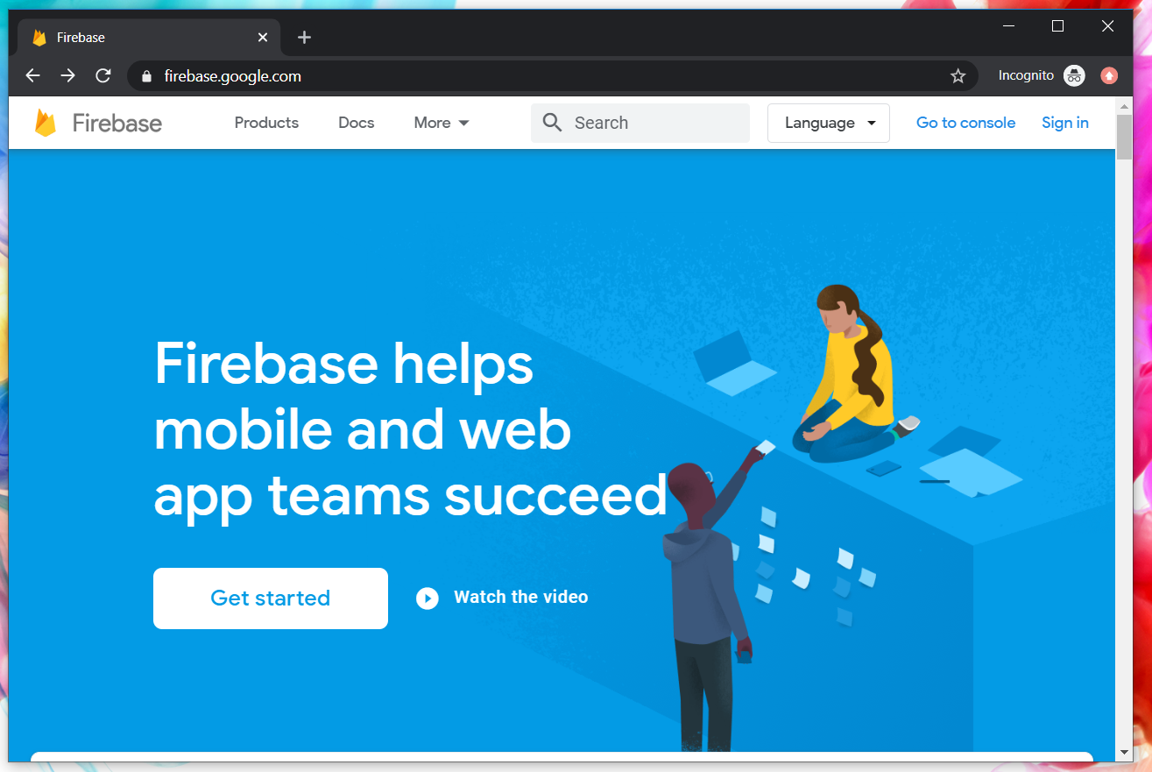
Google Firebase : Console
https://console.firebase.google.com/

Slide 131
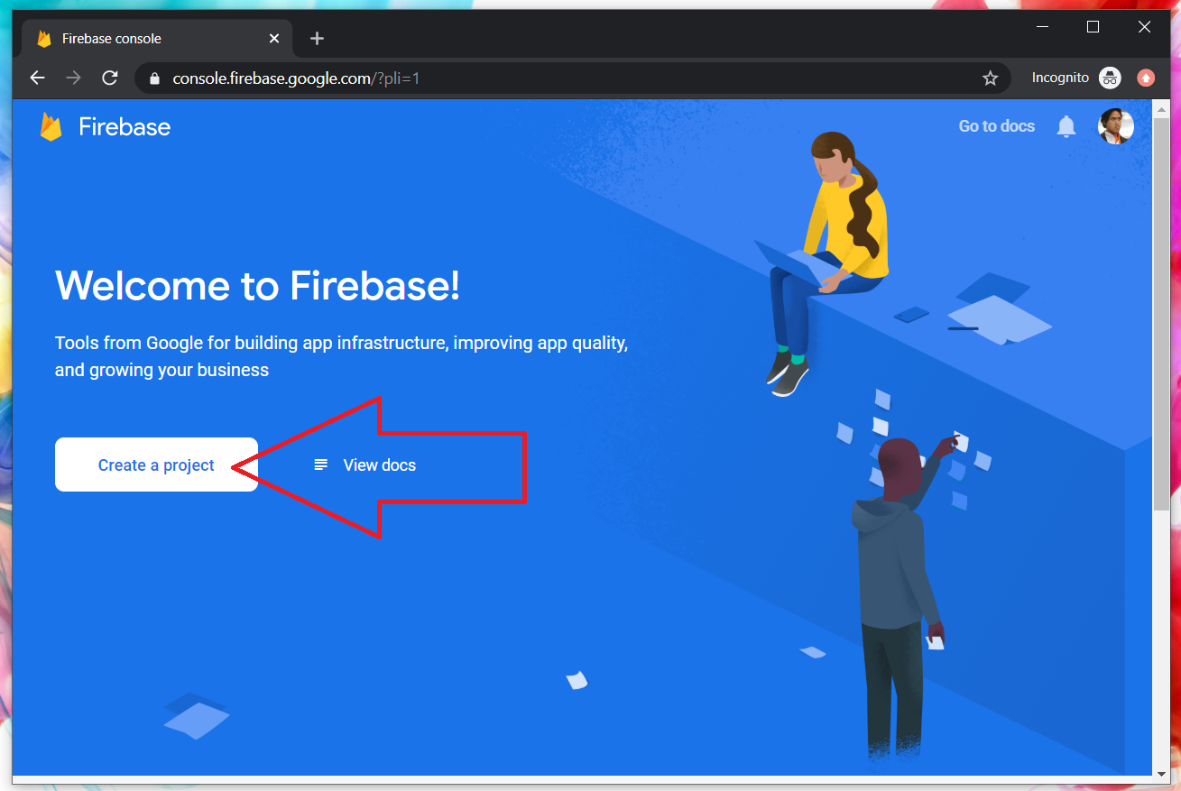
Google Firebase : Create new project

Slide 132
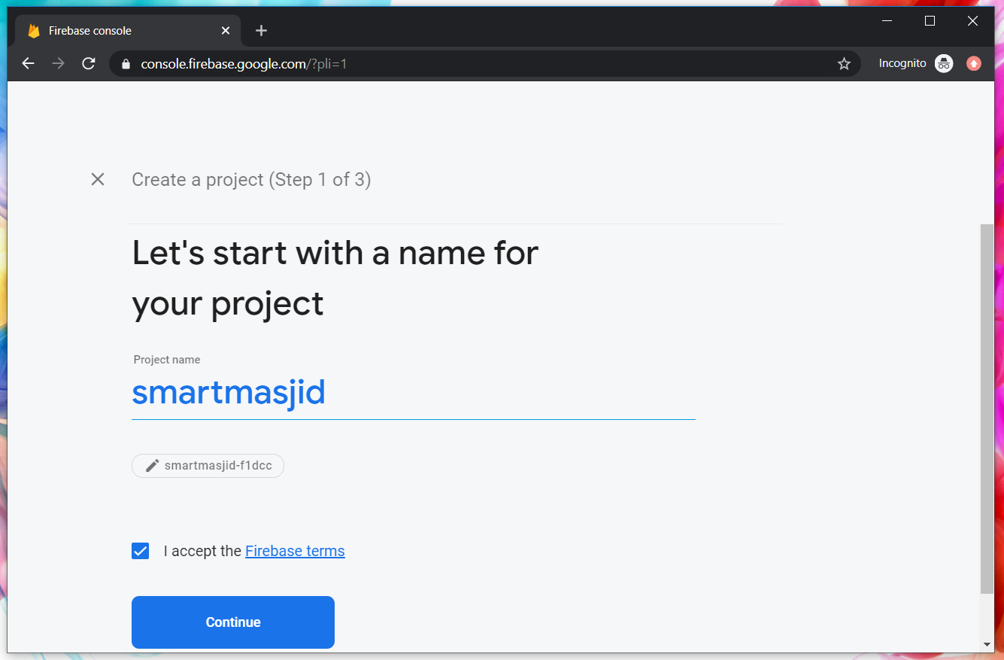
Google Firebase : Project name
sharefstm

Slide 133
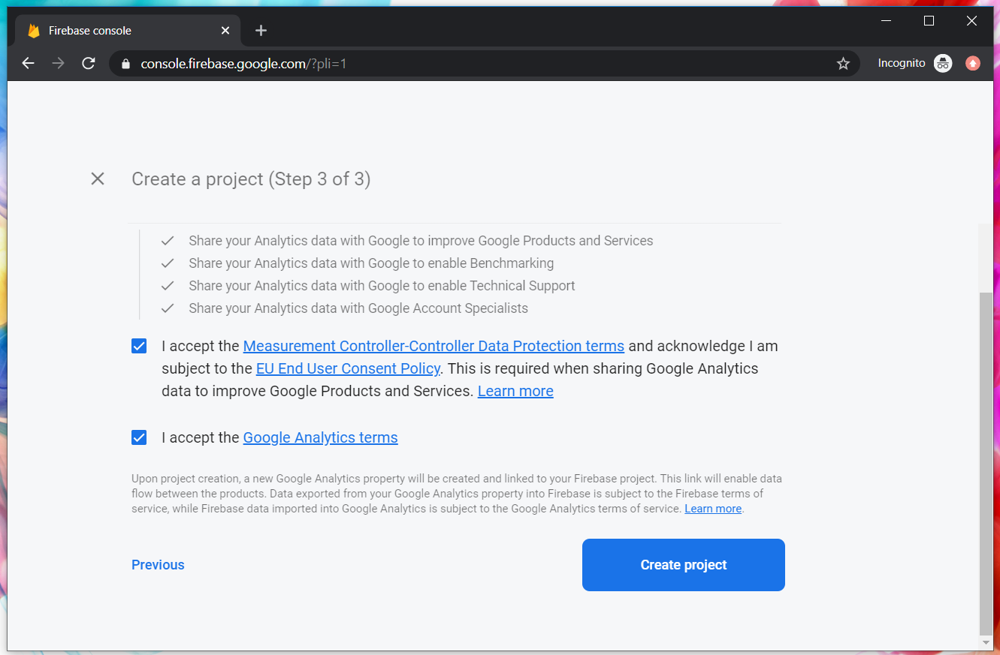
Google Firebase : Accept T&C

Slide 134
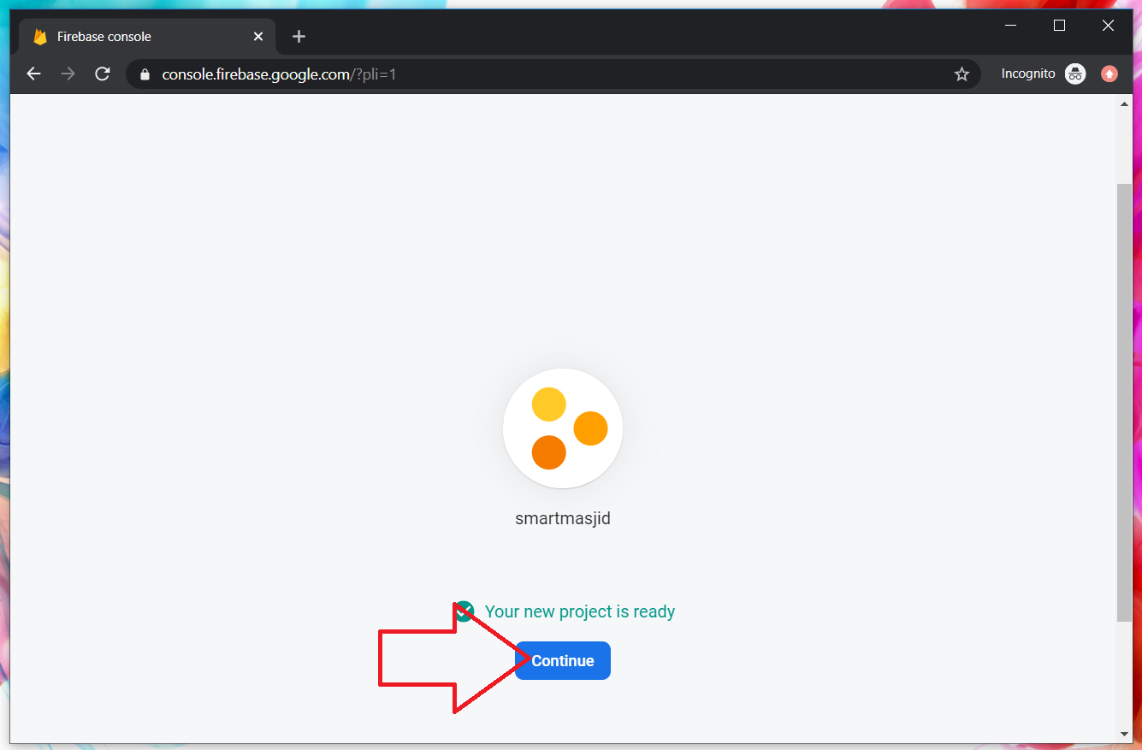
Google Firebase : Project ready and continue
makanapps

Slide 135
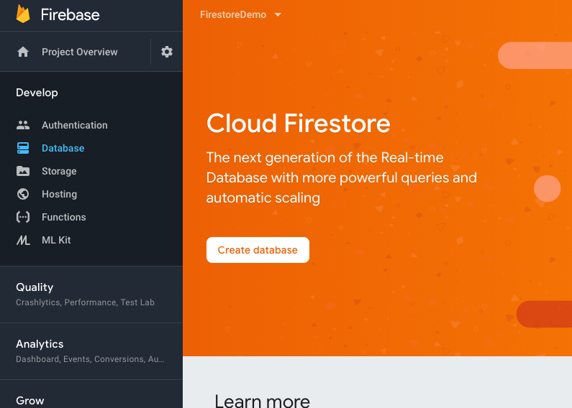
Google Firebase : Realtime database, automatic scaling

Slide 136
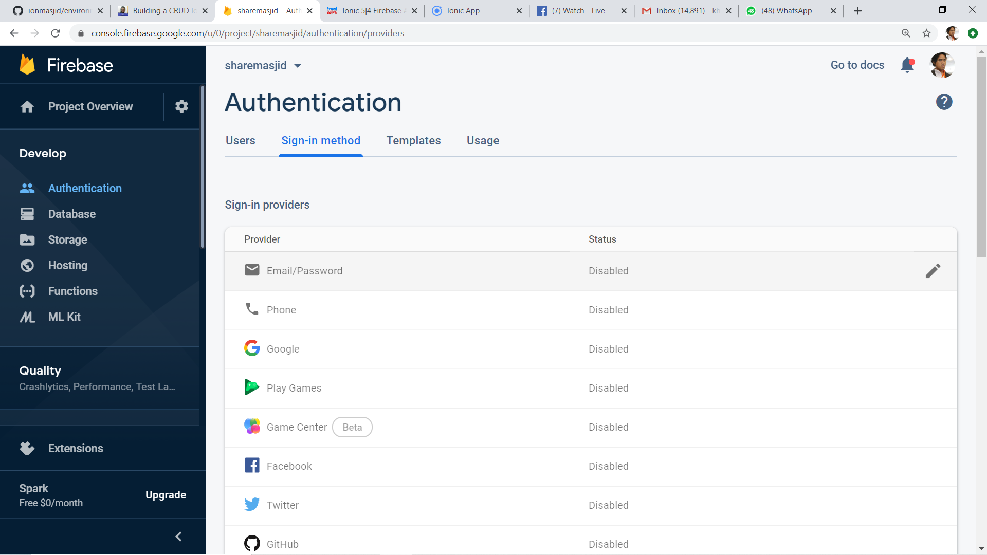
2
1
3

Slide 137
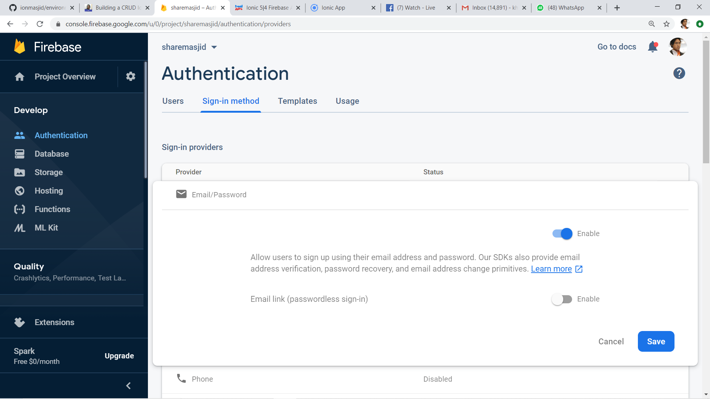
1
2

Slide 138

Google Firebase : Enable test mode

Slide 139

Google Firestore : add Firebase to app

Slide 140

Web Apps Firebase Configuration : Copy the highlighted

Slide 141

T11 Auth + Register
(daftar pengguna)

Slide 142

Create new Ionic project
ionic start sharefstm blank
Page 1: home

Slide 143

Filename src/app/home/home.page.html

Slide 144
Paste the Firebase configuration to environtment.ts
In environment.ts
…
export const environment : {
production: false,
firebaseConfig: {
apiKey: "AIzXXXXXXXXXXXXXXXWZMPN90HFrp4",
authDomain: "test-projeXXXXXXX.firebaseapp.com",
databaseURL: "https://test-projeXXXXXXX.firebaseio.com",
projectId: "test-projeXXXXXXX7",
storageBucket: "test-projeXXXXXXXX.appspot.com",
messagingSenderId: "446XXXXXX105"
}
};
…

Slide 145
Install AngularFirebase plugins
npm install firebase @angular/fire --save

Slide 146
Filename src/app/app.module.ts
//src/app/app.module.ts
…
//firebase & auth
import { AngularFireModule } from '@angular/fire';
import { AngularFireAuthModule } from '@angular/fire/auth';
import { environment } from '../environments/environment';
…
imports: [BrowserModule, IonicModule.forRoot(), AppRoutingModule,
//firebase & auth
AngularFireAuthModule,
AngularFireModule.initializeApp(environment.firebaseConfig),
…

Slide 147
Create globally accessible functions in folder services
ionic g service services/firebase
import { AngularFireAuth } from '@angular/fire/auth';
…
export class FirebaseService {
constructor(
private afAuth: AngularFireAuth
) { }
registerUser(email, password) {
return new Promise<any>((resolve, reject) => {
this.afAuth.createUserWithEmailAndPassword(email, password)
.then(
res => resolve(res),
err => reject(err))
})
}

Slide 148

Add another page
ionic g page daftar
Page 2: daftar

Slide 149

Filename src/app/daftar/daftar.page.html

Slide 150

Filename src/app/daftar/daftar.page.html

Slide 151

Filename src/app/daftar/daftar.page.ts

Slide 152

Filename src/app/daftar/daftar.page.ts

Slide 153


Slide 154
T12 Auth + Login
(pengesahan pengguna)

Slide 155
github.com/khirulnizam/ionic5 wasap.my/60129034614

Slide 156
Add globally accessible functions in folder services
ionic g service services/firebase
import { AngularFireAuth } from '@angular/fire/auth';
…
loginUser(email, password) { //function loginUser
return new Promise<any>((resolve, reject) => {
//authenticating with email & password
this.afAuth.signInWithEmailAndPassword(email, password)
.then(
res => resolve(res), //successful
err => reject(err)) //rejected
})
}//end loginUser
…

Slide 157

Add another page
ionic g page login
Page 3: login

Slide 158

Filename src/app/login/login.page.html

Slide 159

Filename src/app/login/login.page.html

Slide 160
Filename src/app/login/login.page.ts
…
cubalogin(email, password) {
this.fService.loginUser(this.email, this.password)
.then(res => {
console.log(res);
this.errorMessage = "";
//this.navCtrl.navigateForward('/dashboard');
}, err => {
this.errorMessage = err.message;
})
}//end cubalogin
…

Slide 161
github.com/khirulnizam/ionic5 wasap.my/60129034614

Slide 162




CRUDS

Slide 163

T13 Rekod Baharu
(insert new record)

Slide 164
github.com/khirulnizam/ionic5 wasap.my/60129034614

Slide 165
T14 Papar Senarai Rekod

Slide 166
github.com/khirulnizam/ionic5 wasap.my/60129034614

Slide 167
T15 Carian

Slide 168
github.com/khirulnizam/ionic5 wasap.my/60129034614

Slide 169
T16 Kemaskini
(update record)

Slide 170
github.com/khirulnizam/ionic5 wasap.my/60129034614

Slide 171
T17 Padam
(delete record)

Slide 172
Ionic5
Online Workshop
12&13 Nov 2020
9am-12noon
Google Meet

Slide 173

Pengujian apps pada Android Emulator

Slide 174

Download Android Studio https://developer.android.com/studio

Slide 175

File -> New -> New Project

Slide 176

Package name

Slide 177

Tools -> AVD Manager

Slide 178

+ Create Virtual Device

Slide 179

Minimal resolution device

Slide 180

Choose available Android system image

Slide 181

If system image not yet available
Download Android
system image for
1.5GB! (estimation)

Slide 182

AVD name
Click Finish

Slide 183

Run Android Virtual Device

Slide 184

Run
Shift+F10

Slide 185

Apps is
Running
On AVD

Slide 186
Slides & materials github.com/khirulnizam/ionic5

Slide 187


Muatnaik Apps ke
Google Playstore
Fblive FSTM KUIS
11pg 6Nov 2020 (Jumaat)

Slide 188

←App ID

Slide 189

Play.google.com
Register for a developer ID
USD25 for life.
Another consideration: you need to pay through Google Wallet, using a credit card. https://play.google.com/apps/publish/

Slide 190
Playstore Graphic Materials
high-res icon. (size 512px x 512px)
Featured graphic. (size 1024px x 500px)
at least 2 non-Android TV screenshots. (2 screenshot images. Min length for any side: 320px)

Slide 191

Samples of graphic materials & signed bundle/APK

Slide 192
Graphic materials github.com/khirulnizam/ionic5

Slide 193



Slide 194


bit.ly/m-mathurat
(ionic)

Slide 195
https://ionicframework.com/docs/cli/commands/cordova-resources
Graphic materials
resources/icon.png (with size 1024x1024)
resources/splash.png (with size 2732x2732)

Slide 196

https://ionicframework.com/docs/cli/commands/cordova-resources
Graphic materials
resources/icon.png (with size 1024x1024)
resources/splash.png (with size 2732x2732)
(create folder resources)
splash.png
(2732x2732px)
icon.png (1024x1024px)

Slide 197
https://ionicframework.com/docs/cli/commands/cordova-resources
Commands - CLI
ionic cordova resources

Slide 198

Ionic cordova resources
(created after ionic cordova resources)

Slide 199
In file package.json add
"scripts": {
…
"resources":"cordova-res --skip-config --copy",
…
}

Slide 200
ionic capacitor add android
ionic build
npm install jetifier
npx jetifier
npx cap sync android
npx cap open android

Slide 201
Build, copy and open in Android Studioclz
ionic capacitor add android (sekiranya belum)
ionic build
npx cap sync android
npm install capacitor-resources -g
cordova-res --skip-config --copy
npx cap open android
Run apps in Android Studio
cordova-res to copy icon/splash from resources to Android project res folder

Slide 202

Flutter & Ionic
khirulnizam.com

Slide 203

Jana cover ebook
khirulnizam.com

